Slide 1
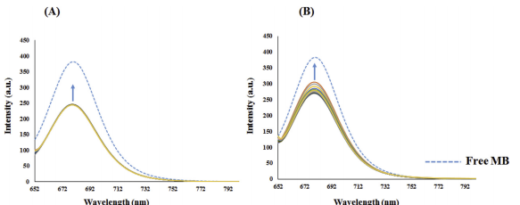
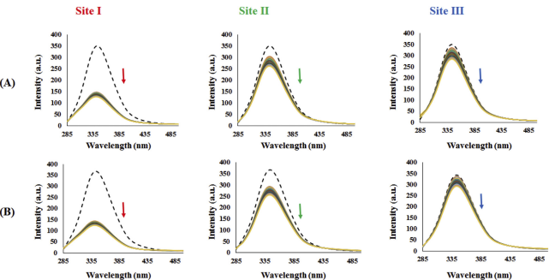
New phosphorus ylide palladacyclic: Synthesis, characterization, X-Ray crystal structure, biomolecular interaction studies, molecular docking and in vitro cytotoxicity evaluations
Sample Preparation
Analytical Results
Synthesis of [Pd(ClCH2COCH(PPh3)L)]Cl, L=PPh3
Phosphorus ylide was prepared. Then, palladium (II) acetate was added to a solution of monophosphonium salt in 15 mL of methanol and the resulting solution was stirred at room temperature for 24 h. Then the solution was concentrated by reducing the solvent in vacuum to 2 mL. N-hexane was then added to separate [Pd(ClCH2COCHPPh3)(μ-Cl)]2 as an orange solid washed with diethyl ether, collected and air-dried. After that, PPh3 was added to said solid in dichloromethane. The resulting mixture was stirred at room temperature for 12 h. The suspension formed was filtered off, washed with diethyl ether, and dried.
Synthesis of [Pd(ClCH2COCH(PPh3)L)]Cl, L= Py
Pyridine was added to a solution of [Pd(ClCH2COCHPPh3)(μ-Cl)]2 in dichloromethane. The resulting mixture was stirred at room temperature for 12 h. The suspension formed was filtered off, washed with diethyl ether, collected, and dried to give a brown powder.
For DNA-binding studies, CT-DNA was prepared in the Tris-HCl buffer and stored at 4 C, and they were done at room temperature by electronic absorption spectroscopy and fluorescence spectroscopy measurement
The fluorescence intensity of MB-DNA was increased by adding the complexes.
The effect of site markers, Eosin-Y (site I), ibuprofen (site II) and digoxin (site III) upon the emission of the complex 1 (A) and the complex 2 (B), as connected to BSA. [BSA] = [site markers] = 6 x 10⁶ M; [Complex] = (0-6x10⁵ M). (- - - - free BSA).
Fluorescence spectroscopy was used to determine the DNA binding properties of the prepared complexes. It can also be used to establish the interaction between the complex and proteins (BSA)
Reference: K. Karami et al. / Journal of Organometallic Chemistry 878 (2018) 60-76

